Slide 1



opentelemetry
An introduction to opentelemetry

Slide 2
What is opentelemetry?
Vendor-neutral standard
Tools, APIs and SDKs
Instrument, generate, collect and export
Open Source

Slide 3
Why opentelemetry?
Standardised
Compatible with multiple services
Handles telemetry data transferral
Collector (high-level, elaborate later)

Slide 4
Tracing
Why? | What?
Exact recording of critical errors | Recording the lifetime of a request
Record normal procedures for analysis | A trace consists of a tree of spans
Examine edge cases

Slide 5
Example traces
Put pics of traces/spans here and explain

Slide 6
Spans
Stopwatches
Contain tags, events, errors, duration
Represent work done by services/components
Context
Context Extracted
Child Span
New Spans?
Request Handled
Context Injected
Span Finishes
Notes:
Plan exact wording of context explanation

Slide 7
Metrics
Logs
Data recorded at regular intervals
Counters, measures, observables
Text
Timestamped
Contain Trace IDs

Slide 8
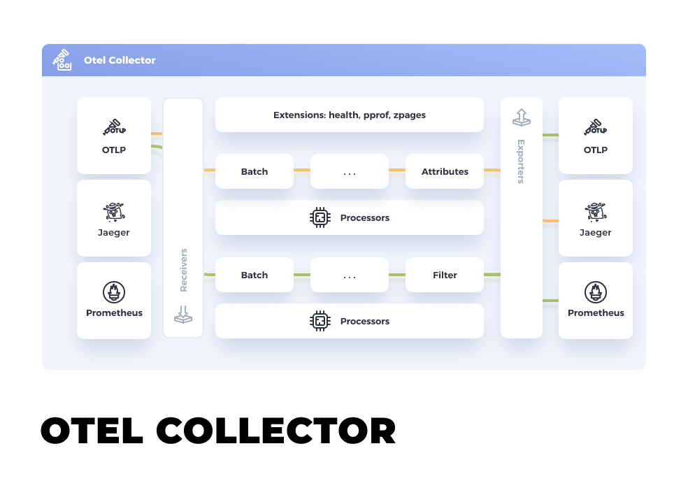
Collector
Middleman between services and observability tools
Can sample, filter and refine data
Contrib version offers extra functionality

Slide 9
Instrumentation
Automatic | Manual
Creation and sending of spans handled for you | More control over how many spans
Libraries can extend to propagation | More control over data/metadata

Slide 10
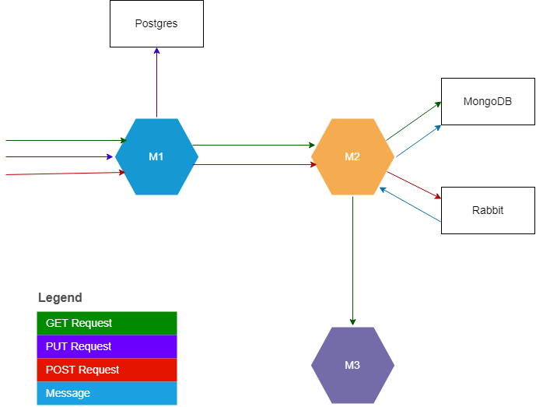
System Overview
Notes:
Create a telemetry diagram and put alongside sys diagram

Slide 11
.NET 6.0 Instrumentation

Slide 12
Collector configuration

Slide 13
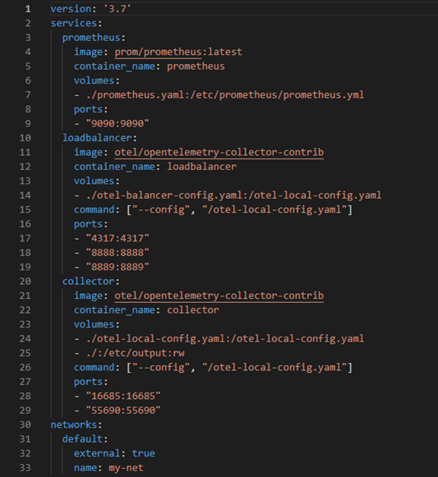
Notes:
docker-compose.yaml

Slide 14
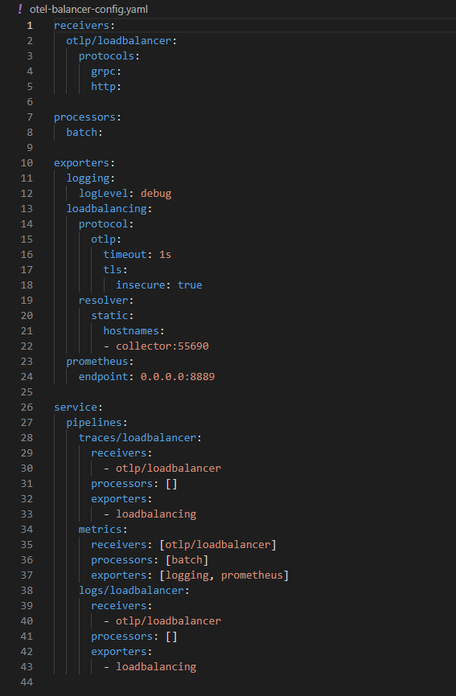

Slide 15
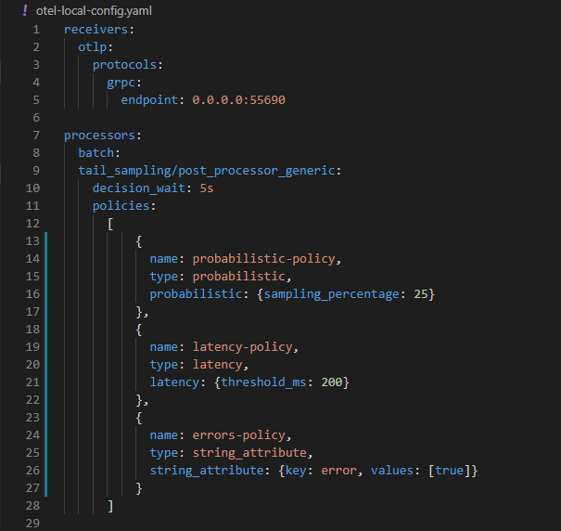

Slide 16
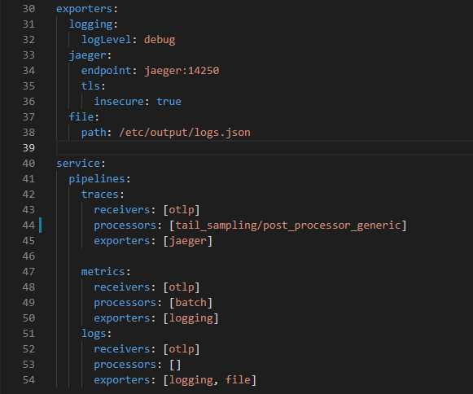

Slide 17
Live demo

Slide 18
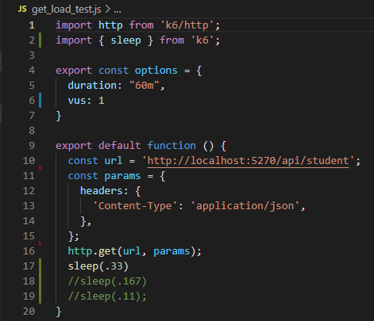
Load testing
Utilised k6 for load testing
Test cases varying in intensity

Slide 19
Load test results
Insert pic, discuss

Slide 20
Further information
Potential tail-sampler deprecation
No unstable features
Industry usage of distributed tracing
Notes:
https://link.springer.com/article/10.1007/s10664-021-10063-9

Slide 21
Q&A

